Slide 1
Performance measures

Slide 2
Hey,
You got first rank…
Throw a party

Slide 3
OK Let’s go to KFC

Slide 4
I know the choice of each Friend
Total friends = 100
KFC’an = 60
Non-KFC’an = 40

Slide 5

I will move the guest in KFC and non-KFC
Classifier

Slide 6
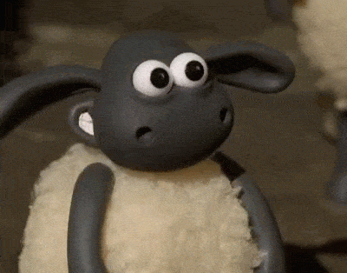

Slide 7
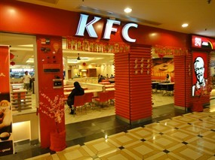
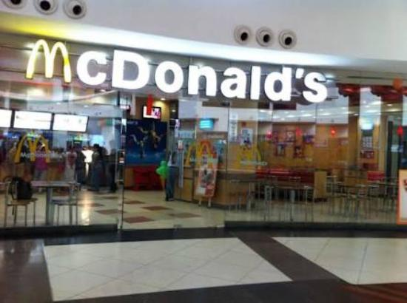
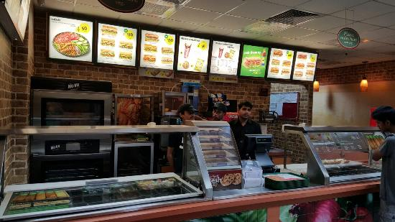
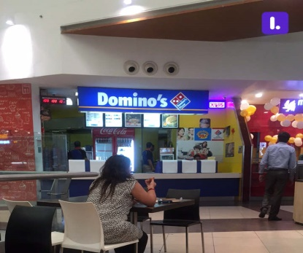


Slide 8


Slide 9

I Should have check the model in prior
Let’s see what happened

Slide 10

How many KFC’an are in KFC

Slide 11
KFC
Other
KFC’an=40
KFC’an=20
non-KFC’an= 20
non-FC’an=20

Slide 12
Accuracy is
Total number of correctly classified friends over total friends
$$Accuracy=\frac{\text{KFC}\text{’}\text{an} \text{who} \text{seated} \text{in} \text{KFC}\text{+ }\text{Non} \text{KFC}\text{′}\text{an} \text{who} \text{were} \text{not} \text{seated} \text{on} \text{KFC}}{\text{T}\text{otal} \text{no}\text{. }\text{of} \text{Friends} }$$

Slide 13
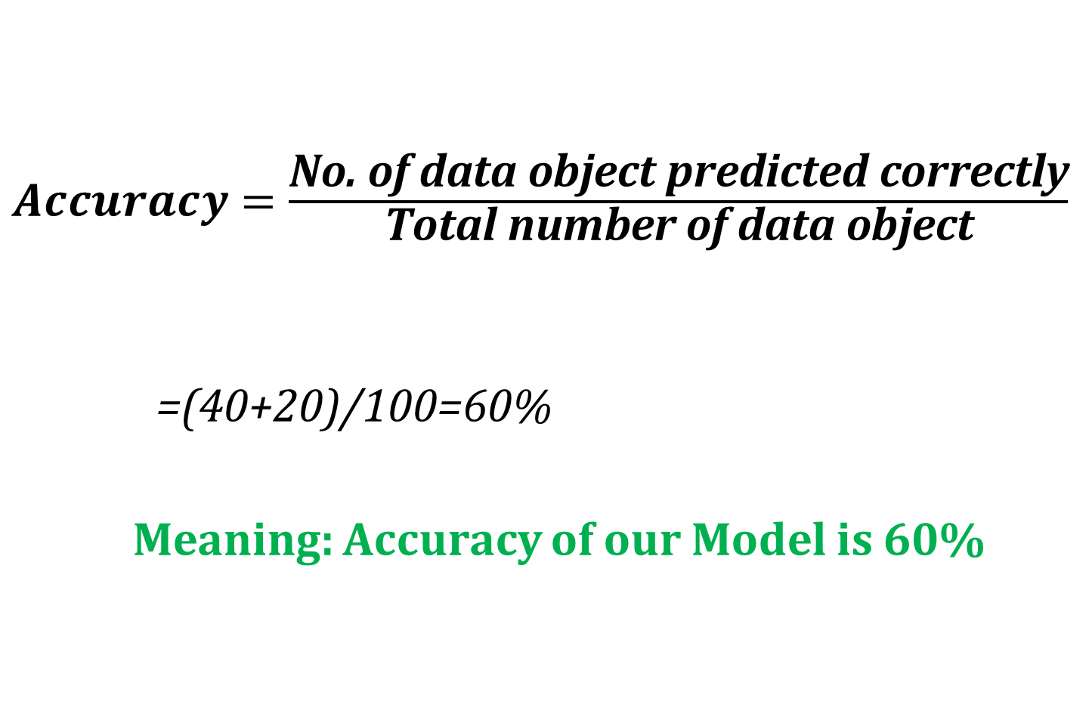
$Accuracy=\frac{\text{No}\text{. }\text{of} \text{data} \text{object} \text{predicted} \text{correctly}}{\text{Total} \text{number} \text{of} \text{data} \text{object}}$
=(40+20)/100=60%
Meaning: Accuracy of our Model is 60%

Slide 14

99 negative classes and 1 positive classes
Explanation:
What happened if 99 people are Non-KFC’an ?? And our model worked well and he shifted 99 friends to non KFC’an shops.

Slide 15
Then what is the Accuracy of this model
99/100 i.e. 99%
Therefore classification accuracy alone can be misleading if you have an unequal number of observations in each class or if you have more than two classes in your dataset.
Misleading

Slide 16
Performance measures are used to calculate
The efficiency of an algorithm
Performance measures for Classification are:
Accuracy, Purity, Precision, Recall, F-measure

Slide 17

To calculate all the performance measures we need a matrix named as a………..

Slide 18

CONFUSION MATRIX
 | P’ (Predicted) | N’ (Predicted)
P (Actual) | True Positive (TP) | False Negative (FN)
N (Actual) | False Positive (FP) | True Negative (TN)
A confusion matrix is a technique for summarizing the performance of a classification algorithm.
Calculating a confusion matrix can give you a better idea of what your classification model is getting right and what types of errors it is making.

Slide 19
In our case
Positive class is KFC’an and
Negative class is non-KFCN’an.

Slide 20
True Positive: Predict KFC’an as KFCan . (TPR=SENSITIVITY)
False positive: Predict: KFC’an as non-KFC’an.
False Negative: Predict non-KFC’an as KFC’an.
True Negative: Predict non-KFC’an as non-KFC’an. (TNR=SPICIFICITY)

Slide 21
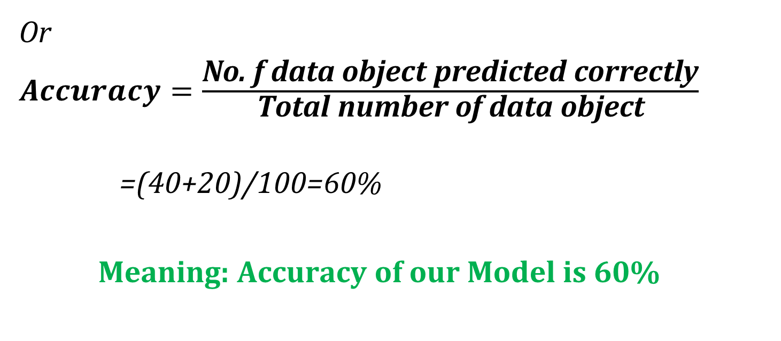
Accuracy
Accuracy = (TP + TN) / (TP + FN + FP + TN)
Or
$Accuracy=\frac{\text{No}\text{. }\text{f} \text{data} \text{object} \text{predicted} \text{correctly}}{\text{Total} \text{number} \text{of} \text{data} \text{object}}$
=(40+20)/100=60%
Meaning: Accuracy of our Model is 60%

Slide 22
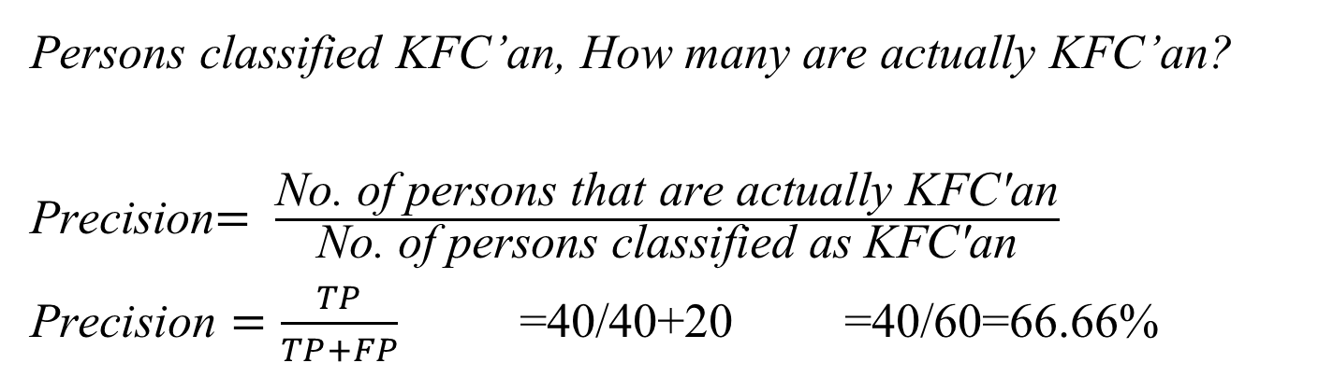
Precision
Persons classified KFC’an, How many are actually KFC’an?
Precision$= \frac{\text{No}\text{. }\text{of} \text{persons} \text{that} \text{are} \text{actually} \text{KFC}\text{′}\text{an}}{\text{No}\text{. }\text{of} \text{persons} \text{classified} \text{as} \text{KFC}\text{′}\text{an}}$
$\text{Precision}=\frac{TP}{TP+FP}$ =40/40+20 =40/60=66.66%
KFC
other
KFC’an=40
KFC’an=20
non-KFC’an= 20
non-FC’an=20

Slide 23
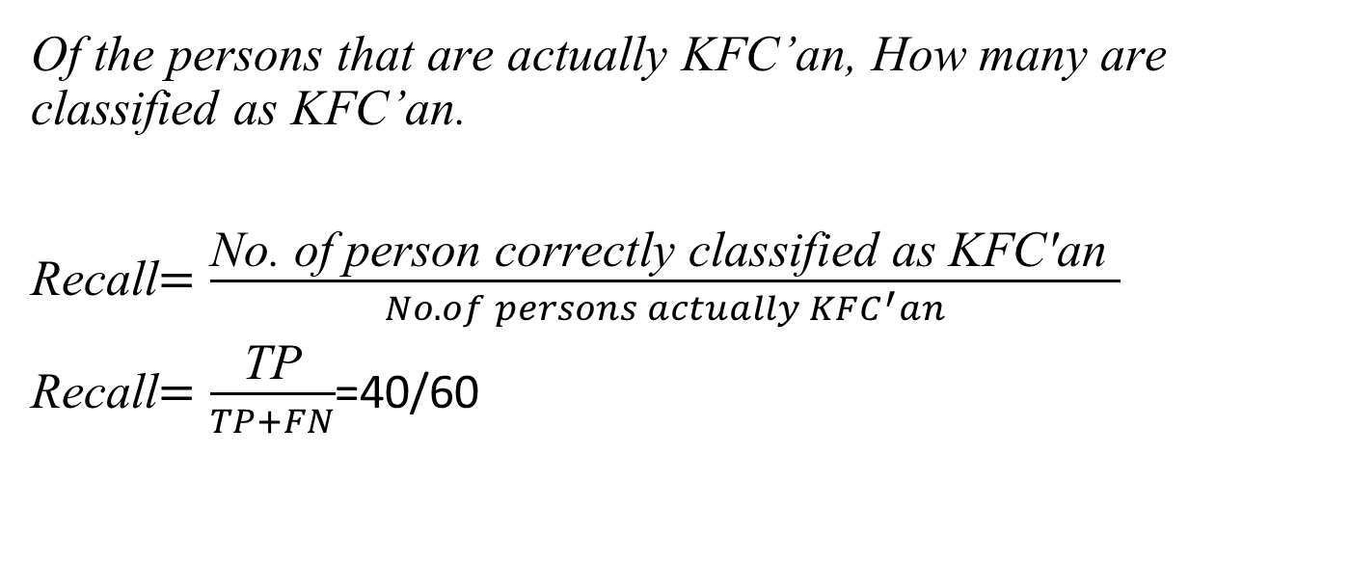
Recall
Of the persons that are actually KFC’an, How many are classified as KFC’an.
Recall$=\frac{\text{No}\text{. }\text{of} \text{person} \text{correctly} \text{classified} \text{as} \text{KFC}\text{′}\text{an} }{No. of persons actually KFC^{′}an}$
Recall$=\frac{\text{TP}}{TP+FN}$=40/60
KFC
other
KFC’an=40
KFC’an=20
non-KFC’an= 20
non-FC’an=20

Slide 24
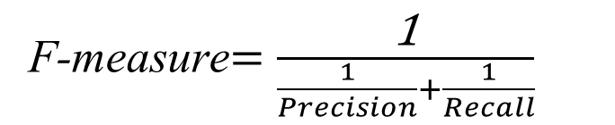
F-measure
When we need to compare two systems.
Assume
System 1 Precision=60% Recall=70% | System 2 Precision=50% Recall=80%
F-measure$=\frac{\text{1}}{\frac{1}{Precision}+\frac{1}{Recall}}$

Slide 25
Thank you

